Slide 1

FOODIE APPLICATION
Presented By:
Ankur Chaurasia
Hari Krishna Sonu Chauhan

Slide 2

Project Goal
Application allows a customer to order food from multiple restaurants which have registered with the application.
Application allows vendor to add restaurant and cuisines in the database.

Slide 3
PAIN POINTS
Due to lockdown, going to restaurant has been hassled for many of us, so our goal is to provide people with an option to order food from home.
The vendors are also facing challenge in getting customers for their restaurant so our application allows the vendors to list their inventory and get customers online.

Slide 4
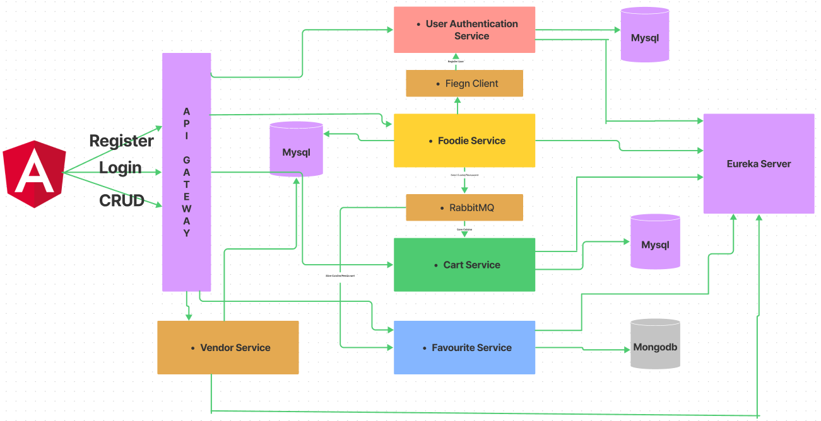
Project Architecture Diagram

Slide 5
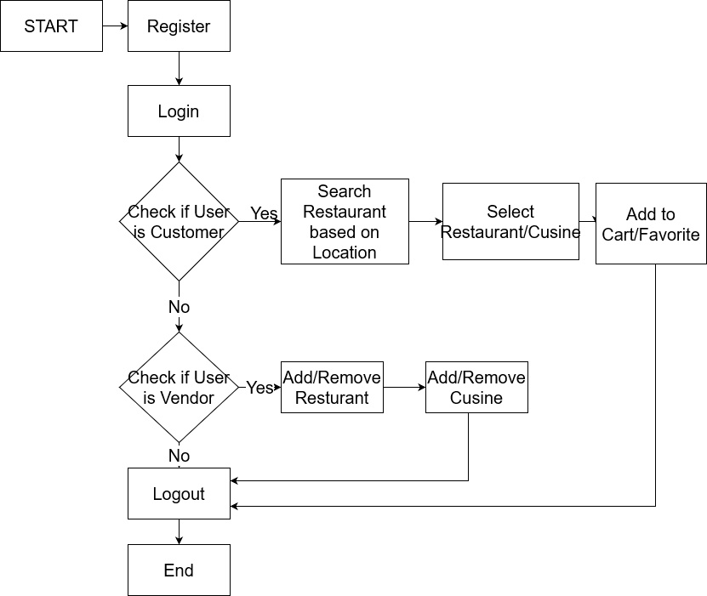
Project Work Flow Diagram
Landing Page

Slide 6

Backend- Foodie Microservice
The application is a microservice which consists of the following services
API Gateway Service
Eureka Discovery Service
Foodie Service
Cart Service
Favorite Service
Vendor Service
User Authentication Service

Slide 7
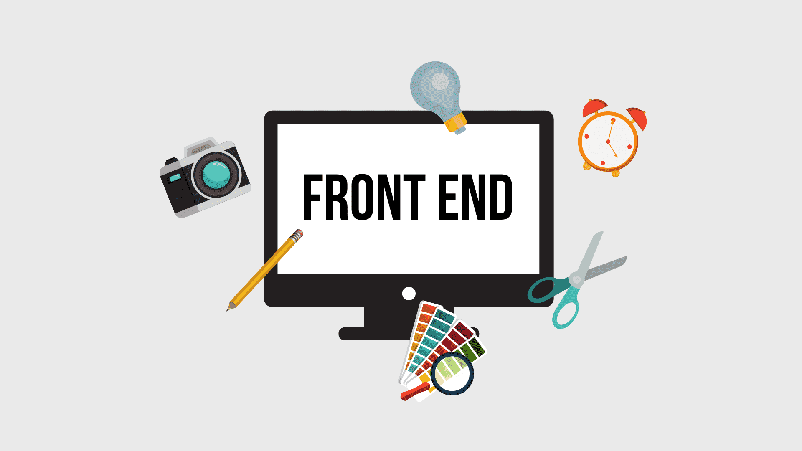
Frontend- Angular and Bootstrap
The angular application consists of the following components:
Register
Login
Home
Favorite
Cart
Profile
Vendor
Add-Restaurant
Add-Cuisine

Slide 8
Front-end Technologies Used
Angular CLI Framework (v13)
Angular Material
BootStrap (v5)
HTML (v5)
CSS (v3)
TypeScript

Slide 9
Backend Technologies Used
Java (v11)
SpringBoot (v2.6)
Jupiter’s Junit5
Mockito
Netflix-Eureka Server
API-Gateway
RabbitMq
FeigN CLIENT

Slide 10
Other Technologies Used
SQL Database : MySQL (Latest)
NoSQL Database : MongoDB (latest)
GitLAB : RePOSITORY
Docker : Containerizing Application

Slide 11



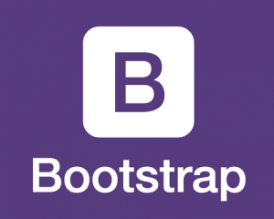










Technologies used in application
T

Slide 12
Project walkthrough

Slide 13


Slide 14


